Slide 1

21/06/24
Emerald Green Power

Slide 2
Main Questions
Ammonia in shipping
Barriers to market adoption of hydrogen technologies
CAPEX and OPEX sources across the hydrogen supply chain

Slide 3
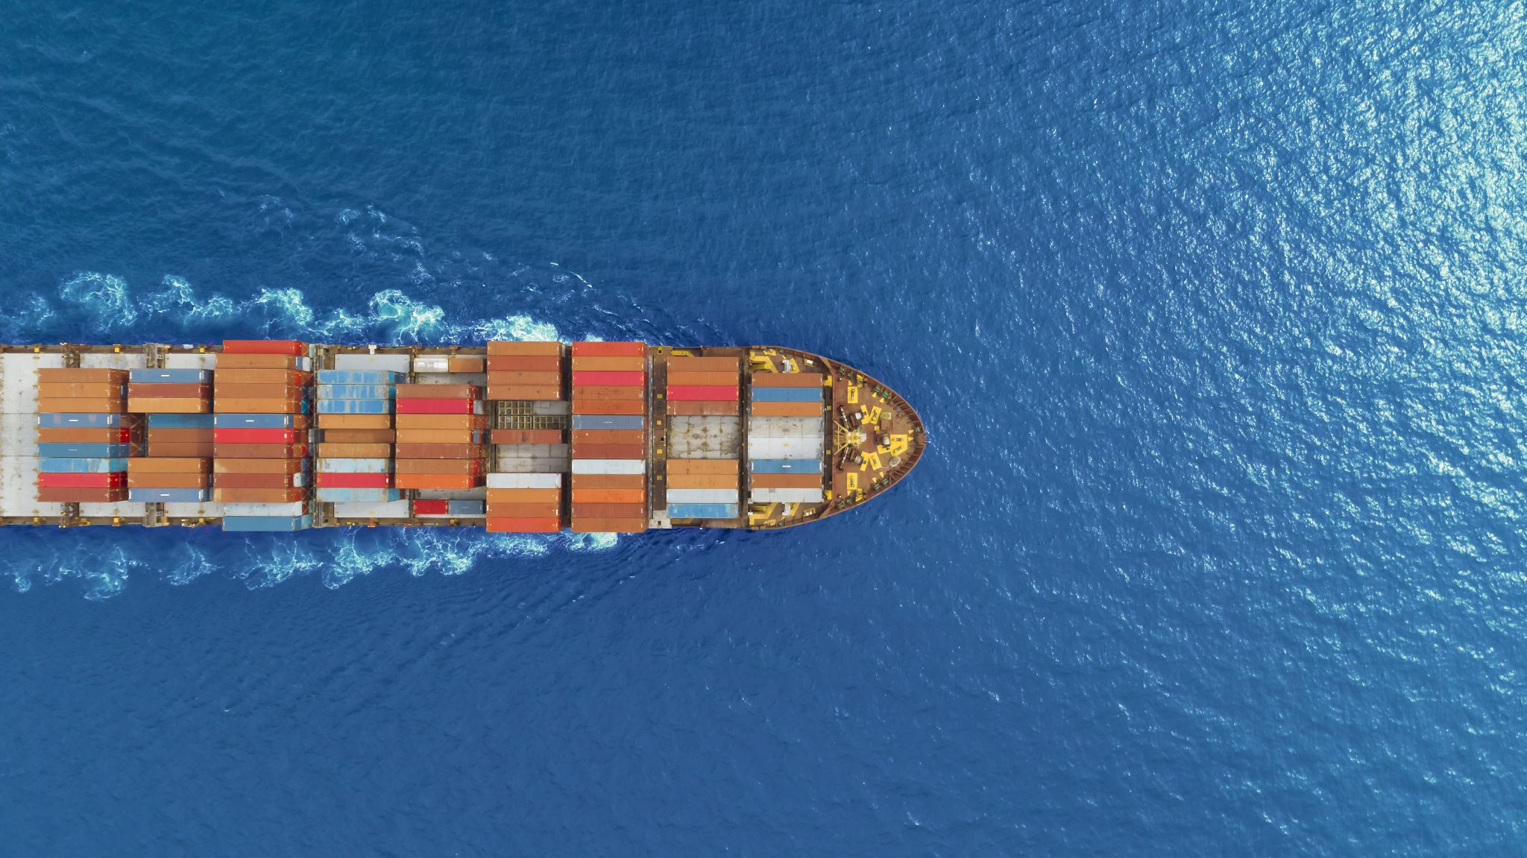
Ammonia in Shipping

Slide 4
Principles of ammonia fuel
Gerlitz, L. et al. (2022) ‘Ammonia as Clean Shipping Fuel for the Baltic Sea Region’, Transport and Telecommunication, Vol 23, no. 1, Pg 102-112
Although not as green as hydrogen, ammonia’s strengths lie in its physical, economic, technological, and social aspects:
Higher volumetric energy density -> lower cost per unit of stored energy
Easier to handle and distribute
Conventional ammonia energy costs comparable to VLSFO
Handling of ammonia is well known from industrial processes
Marine dual-fuel engines for the use of VLSFO and ammonia already exist.
In liquid form, ammonia has comparable physical characteristics concerning temperature, pressure volume and weight for storage and transport like LNG
Notes:
Green ammonia is produced from green hydrogen and can be used as a fuel directly, or for power generation or use in fuel cells.
Aspects include:
Ammonia has a higher volumetric energy density, resulting in lower cost per unit of stored energy.
Its also easier to handle and distribute if the necessary infrastructure is established.
Conventional ammonia energy costs are comparable to energy costs of VLSFO, making ammonia the most economic carbon-free fuel.
The handling of ammonia is well known from industrial processes, therefore, safe usage of ammonia on ships can be assumed.
Global availability of ammonia is safeguarded and marine dual-fuel engines for the use of VLSFO and ammonia already exist.
In liquid form, ammonia has comparable physical characteristics concerning temperature, pressure volume and weight for storage and transport like LNG.
Because of these reasons, ammonia deployment seems feasible, particularly for inland, coastal, and short-sea shipping. (compare to challenges for hydrogen).

Slide 5
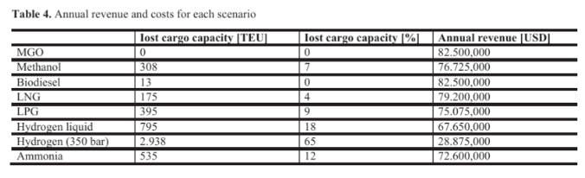
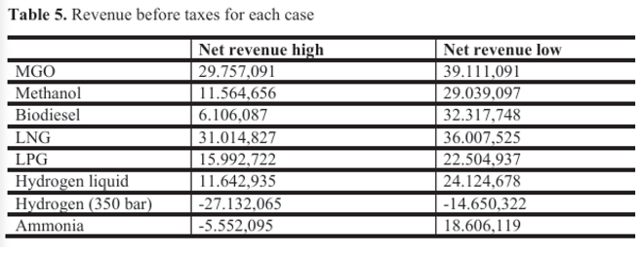
Case study from paper
Gerlitz, L. et al. (2022) ‘Ammonia as Clean Shipping Fuel for the Baltic Sea Region’, Transport and Telecommunication, Vol 23, no. 1, Pg 102-112
Analysed the annual fuel consumption of a 4500 TEU vessel to analyse the effect of hydrogen and ammonia on net annual revenue.
Overall, hydrogen and ammonia result in cargo capacity losses owing to the different fuel volumes. (Table 4)
Then, according to high and low-price scenarios of each fuel throughout the year, the effect on net revenue of the vessel is shown. (Table 5)
Notes:
TEU = 20 feet long, 8 feet wide, 8.5 feet tall shipping container.
Ammonia shows the most cost-intensive fuel costs since ammonia has a low LHV (LHV = amount of heat released by combusting a specified quantity (initially at 25°C)) compared to the other fuels.
However mass is not the defining factor and volume plays a huge part. Hydrogen needs 12x more space than MGO and this means that a huge amount of cargo capacity is lost. This is why although hydrogen liquid results in a higher loss of cargo capacity, its effect on revenue is smaller due to ammonia’s high fuel costs.
Overall, fuel price is the major limiting factor in making hydrogen and ammonia competitive with other fuels.
It is worth noting that for this study, the operational costs (OPEX) have been estimated to be the same for each fuel but certain fuels like hydrogen require more OPEX for cooling and compressing, leading to further cargo space losses (if the ship is 100% fuelled by hydrogen to provide energy for these processes).
In this regard, ammonia requires less cooling than hydrogen to stay liquified, meaning less energy needed and less cargo capacity loss.

Slide 6
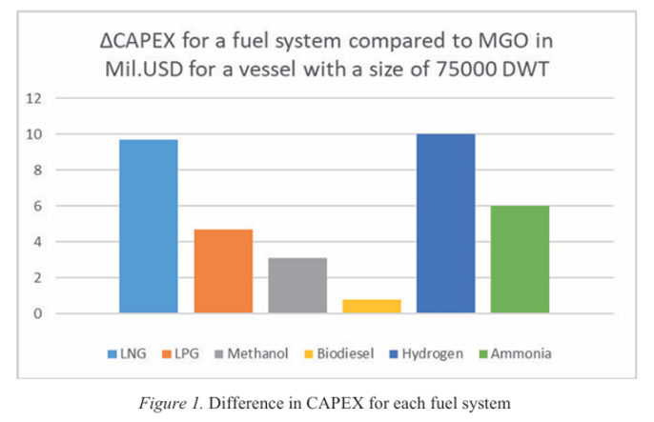
Gerlitz, L. et al. (2022) ‘Ammonia as Clean Shipping Fuel for the Baltic Sea Region’, Transport and Telecommunication, Vol 23, no. 1, Pg 102-112
Notes:
CAPEX of ammonia for an average cargo ship. Ammonia lies inbetween LNG and LPG for CAPEX for lower than hydrogen, which is higher than all of them.

Slide 7
Ammonia distribution costs
Gerlitz, L. et al. (2022) ‘Ammonia as Clean Shipping Fuel for the Baltic Sea Region’, Transport and Telecommunication, Vol 23, no. 1, Pg 102-112
Paper also analysed the storage and distribution of ammonia by comparing a routing analysis of LNG in Brunsbuttel.
Because of the different energy densities of ammonia to fuel such as LNG, ammonia storage costs are higher than LNG.
Furthermore, the distribution of ammonia to vessels via trucks, vessels, or both are in every case significantly higher compared to LNG.
Notes:
Brunsbuttel chosen because it has a central LNG terminal and the same assumption can be made for the ammonia study because Brunsbuttel also contains the only existing German maritime ammonia terminal. Hence, the routing graphs for LNG can be assumed to be the same as for ammonia.
In this study then analysed the storage of ammonia at Brunsbuttel and the subsequent distribution of ammonia to ships at other German ports.
Due to the ratio of LNG density to liquid ammonia energy density, ammonia storage is expected to be approximately 2/3 of the original design, meaning storage costs increase as the storage infrastructure needs to be developed to facilitate the increased volume of ammonia that is going to be stored.
The distribution costs are a result of the upscaling of transport capacities,

Slide 8
Challenges for ammonia
Gerlitz, L. et al. (2022) ‘Ammonia as Clean Shipping Fuel for the Baltic Sea Region’, Transport and Telecommunication, Vol 23, no. 1, Pg 102-112
Technology readiness for ammonia propelled vessels is under construction and the necessary infrastructure and real-world applications of ammonia are still underdeveloped.
Majority of operationalisation challenges for ammonia are land-based, as the fuel is not available in the right locations at the right volumes.
Notes:
Green ammonia is produced from green hydrogen.
Lack of necessary infrastructure highlighted by the fact that only 120 ports are equipped with ammonia trading facilities but in these ports, ammonia only appears as liquid cargo in the maritime business. Of the most important ammonia port terminals, none of them are used as marine fuel bunkering terminals.
Energy density of ammonia is 1/3 of MGO and 1/2 of LNG. This results in significantly higher storage and distribution costs as a result of the need for upscaling of existing infrastructure.

Slide 9
Barriers to market adoption of hydrogen technologies

Slide 10
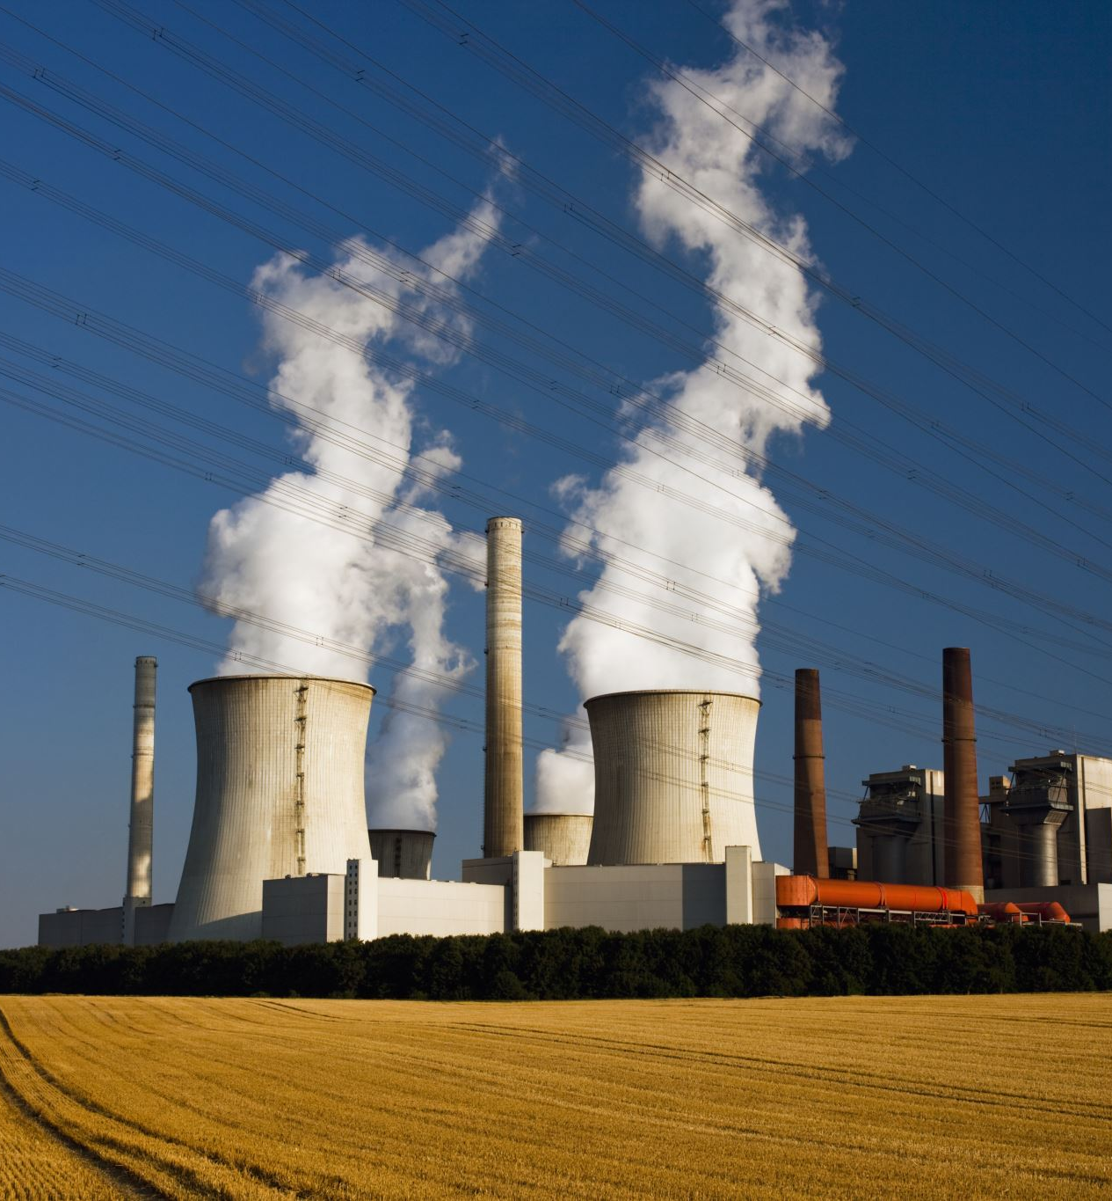
Technological limitations: Improving the efficiency of electrolysis and increasing the energy density of storage systems.
Infrastructure development: Infrastructure is needed across all nodes of the supply chain, and this requires huge investment
Costs and economic feasibility: Green hydrogen currently more expensive than grey hydrogen primarily due to the cost of renewable energy, electrolysis CAPEX, and storage and transportation infrastructure.
Hassan, Q. et al. (2024), ‘Green hydrogen: A pathway to a sustainable energy future’, International Journal of Hydrogen Energy, Volume 50, Part B, Pages 310-333
Notes:
Scalability is also another concern because large-scale deployment of green hydrogen will require massive investments which may not be feasible in the short term.
2. Transportation of hydrogen is also more complicated than other fuels, as hydrogen has a low energy density, making it less economical to transport over long distances. Additionally, retrofitting existing natural gas pipelines to accommodate hydrogen may present technical and safety challenges.
3. As a result, green hydrogen may struggle to compete with other energy sources and hydrogen production methods, unless there is significant cost reduction or supportive policy frameworks in place.

Slide 11
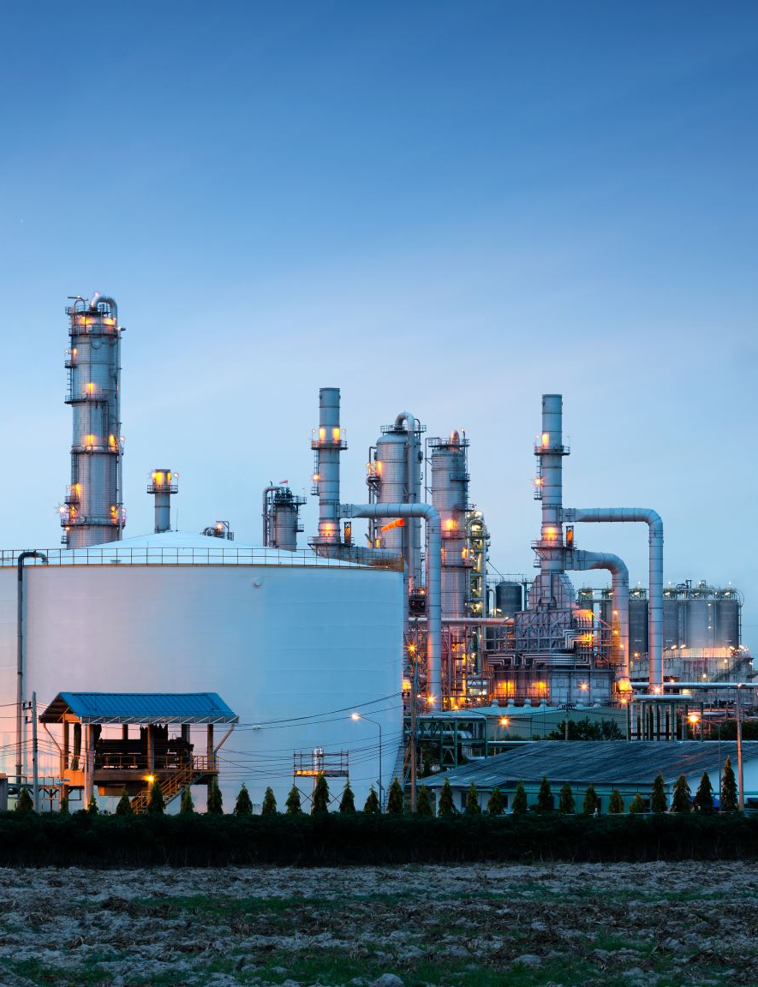
4. Regulatory and policy frameworks: Green hydrogen needs regulations and policy frameworks such as carbon pricing, subsidies, and renewable energy targets to act as incentives and drive the adoption of green hydrogen.
Other regulatory issues include a lack of common approach for the approval for hydrogen ship designs,
5. Public perception and acceptance: Concerns around the safety of hydrogen, given its flammability and potential for explosion. People are also resistant to change and prefer to stick to familiar energy sources like gasoline or natural gas.
Hassan, Q. et al. (2024), ‘Green hydrogen: A pathway to a sustainable energy future’, International Journal of Hydrogen Energy, Volume 50, Part B, Pages 310-333
Notes:
4. These incentives are needed to support the development of port infrastructure because there is currently port operators do not have the incentive to make zero or low-carbon strategic investments and ship operators aren’t willing to adopt hydrogen technologies due to a lack of port infrastructure.
However, creating these policies requires collaboration between governments, industry stakeholders, and researchers, which can be a lengthy and complex process.
5. With regards to this, guidance on the assessment of risks associated with hydrogen technologies is needed. Without these, small shipbuilders will find it difficult to develop vessels, given that they typically lack the experience and skills to develop individual risk-based analyses.

Slide 12
CAPEX and OPEX across the hydrogen supply chain

Slide 13
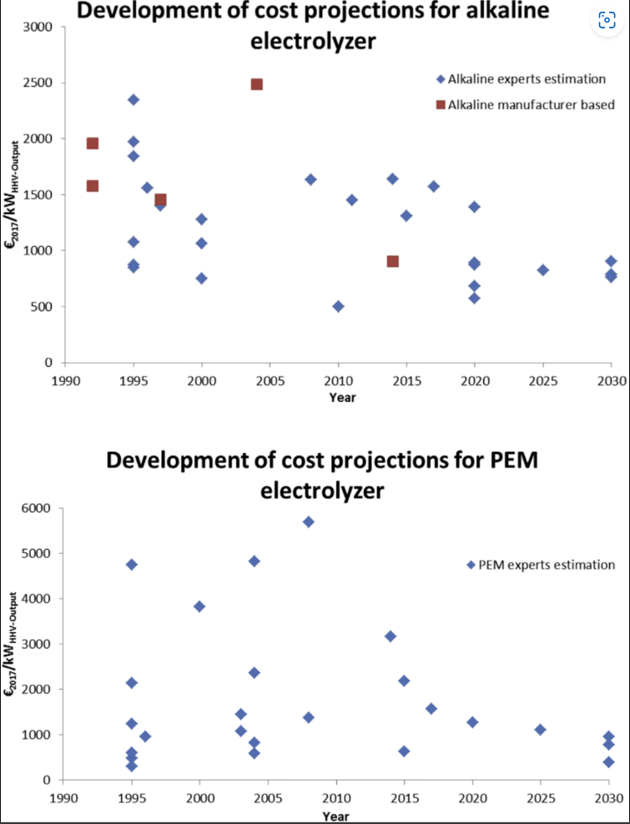
Previous studies on CAPEX and OPEX
Proost, J. (2019) provided an analysis of CAPEX estimations for both alkaline and PEM electrolysis collected from previous studies and manufacturer declarations:
Proost, J. (2019), ‘State-of-the-art CAPEX data for water electrolysers, and their impact on renewable hydrogen price settings, International Journal of Hydrogen Energy, Volume 44, Issue 9, Pages 4407-4412

Slide 14
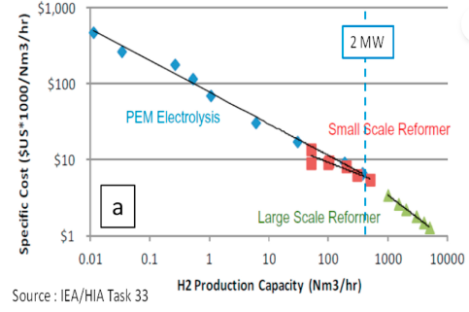
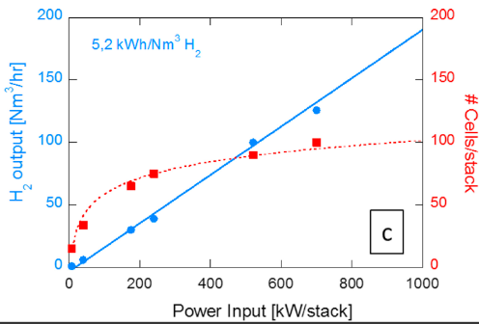
Proost, J. (2019), ‘State-of-the-art CAPEX data for water electrolysers, and their impact on renewable hydrogen price settings, International Journal of Hydrogen Energy, Volume 44, Issue 9, Pages 4407-4412
Using data from the IEA, it is recognised that for electrolysis to become a viable technological choice for hydrogen production, a process intensification into the MW range is crucial.
Notes:
This is necessary not only to make the CAPEX of water electrolysis competitive to SMR hydrogen production, but also to enable coupling to the MW-scale renewable electricity production capacities which are typical of today’s on-shore wind farms. Such a coupling is mandatory for any water electrolyser technology to produce green hydrogen in the MW range.
With respect to the need for intensification into the MW-scale, the data © suggests that 100 cells/stack represents an intrinsic upper limit, corresponding to a 1 MW PEM system. Therefore, for Power-to-Gas applications in the MW range, an electrolyser system based on multiple PEM stacks would be required.

Slide 15
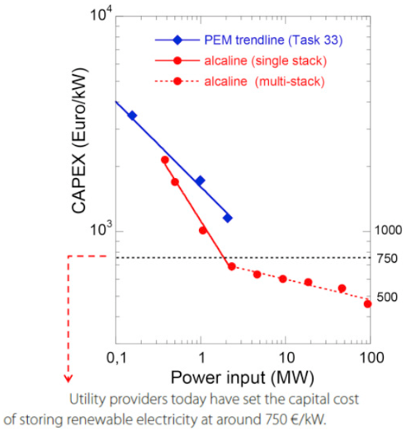
Comparing PEM to Alkaline, alkaline electrolysis demonstrates are much more susceptible to CAPEX reduction upon scaling than PEM.
However when looking at the use of multi-stack systems to reduce CAPEX, PEM systems show a much more pronounced reduction in CAPEX than alkaline systems.
Worth noting that OPEX has not been taken into account here.
Proost, J. (2019), ‘State-of-the-art CAPEX data for water electrolysers, and their impact on renewable hydrogen price settings, International Journal of Hydrogen Energy, Volume 44, Issue 9, Pages 4407-4412
Notes:
A CAPEX of 750 Euro/kW, considered by utility providers to be the capital cost for storing renewable electricity, is already realistic today for a single stack 2MW system.
It should be noted that in the aforementioned CAPEX calculations , life cycle issues of electrolysers and electrodes have not been taken into account. The durability aspect of alkaline stacks currently still very much favours state of the art alkaline vs PEM technologies.
Including such lifetime (and hence OPEX) aspects in the calculation can be expected to somewhat flatten out the projected difference in CAPEX reduction between alkaline and PEM for multi-stack systems.

Slide 16
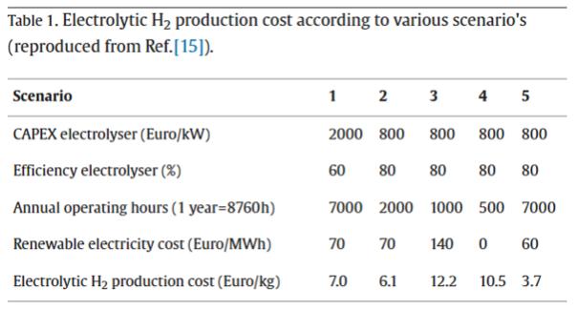
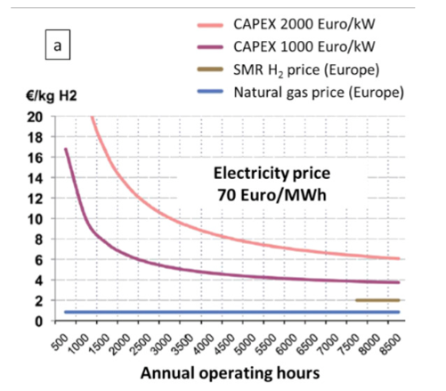
Proost, J. (2019), ‘State-of-the-art CAPEX data for water electrolysers, and their impact on renewable hydrogen price settings, International Journal of Hydrogen Energy, Volume 44, Issue 9, Pages 4407-4412
Taking OPEX into account, electrolyser efficiency, annual operating hours, and renewable energy cost are the main factors affecting the electrolytic hydrogen production cost (Euro/kg).
Graph shows that for an electrolyser uptime of (<2000 hours/year), the cost of hydrogen increases very steeply.
Notes:
Table dates back from 2015 and therefore overestimates current available CAPEX values. However, these provide a useful starting point for identifying the main additional operational parameters for setting a realistic hydrogen price.
From the data, its clear that operating hours of 2000 or less makes the cost of hydrogen not competitive and in the case of 1000 or 500 hours, unacceptable (even if renewable electricity cost was zero).
As a result, the expected annual operating hours is clearly a critical parameter to consider for electrolytic hydrogen cost projections.
One positive from this data is that at current CAPEX values of 700 Euro/kW (considered to be realistic as of today for a 2 MW alkaline electrolyser) an electrolytic H2 production cost below 4 Euro/kg can be obtained once an electrolyser uptime >20% can be guaranteed. Moreover, this cost further decreases to 3 Euro/kg upon further decreases in CAPEX, making hydrogen more competitive.

